Slide 1
Network Project

Slide 2
Team Members
​Name
Mohamed Salah Abd-ElHameed
Abd El-Rahman Hesham
Mohamed Ahmed Ebrahim
Yousef Hassan
Amr Mossad
Mahmoud Mossad

Slide 3
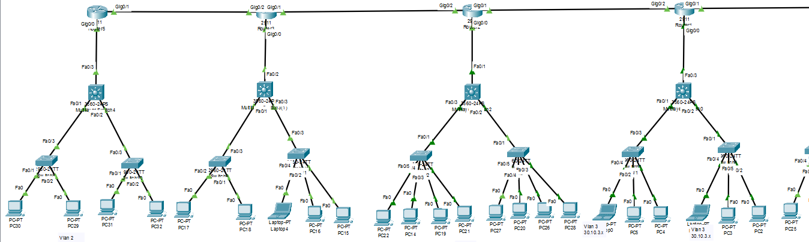
The Network :

Slide 4
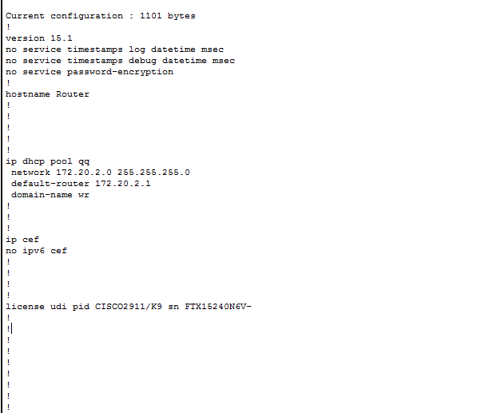
DHCP Successfully

Slide 5
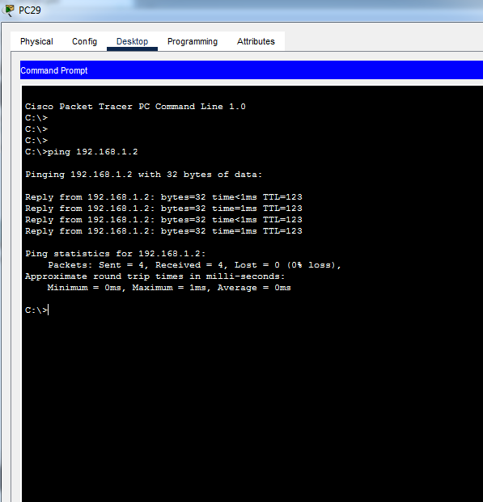
Ping between Devices :

Slide 6
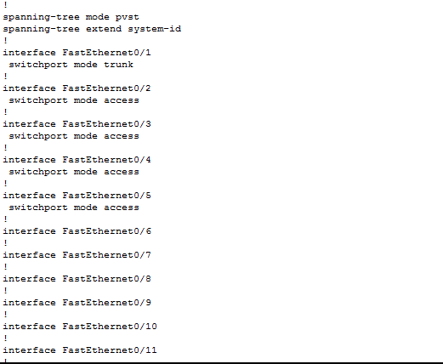
Router Configuration :

Slide 7
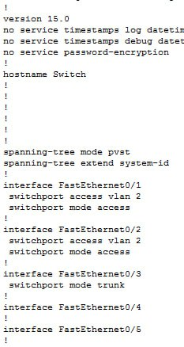
Switch Configurations :

Slide 8
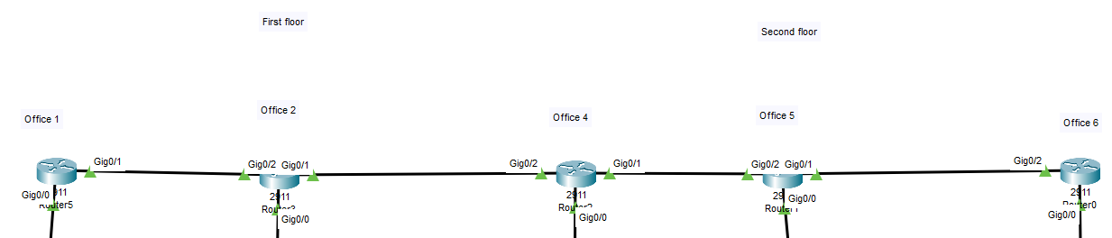
Company Departments

Slide 9
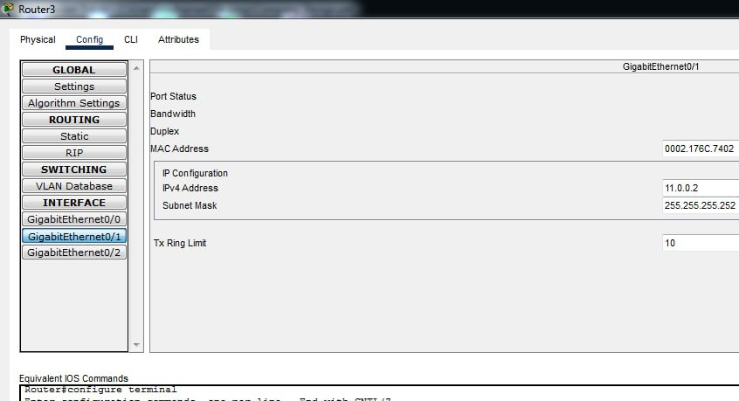
GUI Router Configuration :

